Slide 1
CFD in the Scope of Race Car Development A tool for Aerodynamic Mastery
Jonas Pangerl

Slide 2
Computational Fluid Dynamics
… is the science of using numerical methods to predict flows based on the governing equations of conservation of mass, momentum, and energy.

Slide 3
Agenda
1
2
3
4
CFD Fundamentals
Race Car CFD
Discretization, Turbulence Modelling, Solving, …
Key Aspects of Modelling Race Car Components
A Workflow For Formula Student
Validation and Correlation
All Steps from CAD to Postprocessing
Accuracy, Understanding and Optimizing the CFD Setup

Slide 4
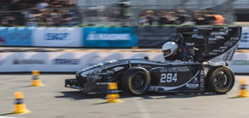
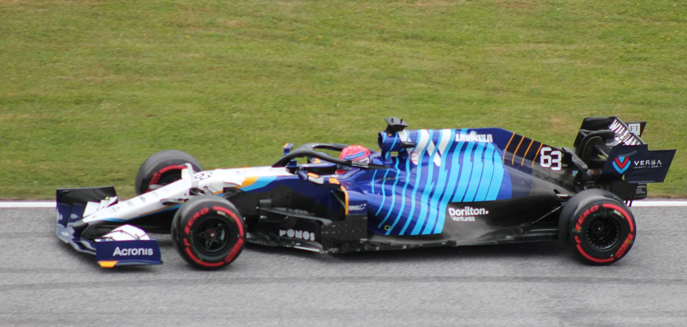
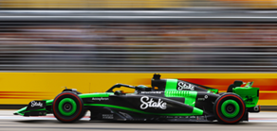
About Me
Rennstall Esslingen
Williams Racing
Sauber Motorsport
Team Leader Aerodynamics
Aerodynamicist, Master Thesis about High Fidelity CFD
CFD Correlation Engineer

Slide 5
CFD for Race Car Development
Aerodynamic Optimization
Cost and Time Efficient
Detailed Flow Analysis
Optimize Aerodynamic Properties, such as Downforce and Drag
No physical Models and very quick turn-around time
Insights into Flow Field, Pressure Distribution and Turbulence Properties
Real-World Conditions
Radical Design Exploration
Adjoint and AI Enhancements
Modeling of real-world Conditions such as curved Flow, Ground Contact and Bouncing
Evaluation of big conceptual Changes and radical Concepts
Sensitivity Analysis, Automated Design Process, AI Analysis and Predictions

Slide 6
Excurs: Boundary Layer Theory
Limit of Boundary Layer
u = 0.99 u_{ꚙ}
Transition Region
Turbulent
Buffer
Layer
Laminar
Viscous
Sublayer
Leading Edge

Slide 7
1
CFD Fundamentals

Slide 8
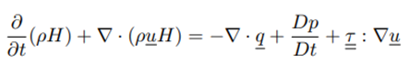
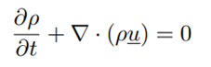
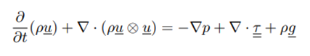
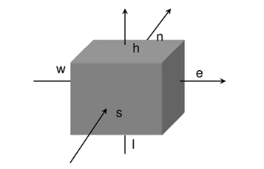

Discretization
The state and changes of a fluid or gas can be described mathematically through the Navier-Stokes Equations
These are partial differential Equations (PDEs)
PDEs can not be solved analytically for real-world problems
Solution:
Approximate the continous equations through discretization with a finite set of elements
Numerical Techniques such as Finite Volume Method (FVM) are used to compute the quantities in each control volume
The continous space is descibed by a finite set of equations that can be handled by the computer
The finer the discretization, the more accurate the solution
Notes:
NS: Conservation of mass, momentum and energy
-NS equations describe changes in flow variables such as velocity, pressure, and temperature across the entire fluid domain continuously
transforms the continuous equations into algebraic equations by discretization

Slide 9
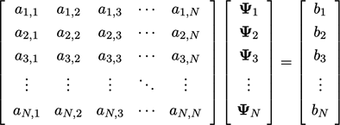
Solving Process
Discretization turned differential equations into a set of algebraic equations
Momentum Equation links velocity components from on cell to the neighbouring cells
Continuity Equation links pressure and velocity
For each cell, we must compute u_{i}, u_{j}, u_{k}, p, …
pressure-velocity link and nonlinear terms do not allow to solve the system in one step
Iterative Solving Process
Notes:
- Focus here is on unstructured grids

Slide 10
Solving Process
Segregated Solver | Coupled Solver
Variables solved sequentially. E.g. First u, then p | Variables solved simultaneously
No direct link between variables in equations Needs correction steps to fullfill continuity equation | Accounts for interaction between variables
Memory efficient, less computational power per iteration (time to solve equations in one iteration) | Requires more memory and more computational power per iteration
May converge slower (more iterations) | Converges faster (fewer iterations)
Notes:
- Focus here is on unstructured grids

Slide 11
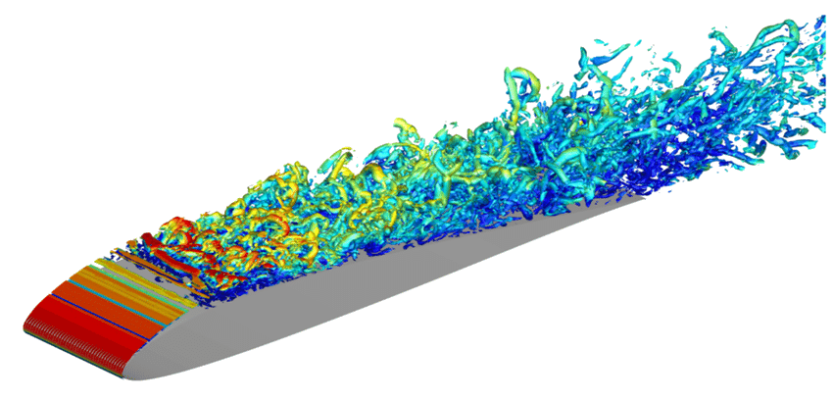
Solving Process
Possible to solve Navier-Stokes equations directly, but it requires:
Resolving all turbulent structures in the flow
Very fine meshes
Time-resolved simulations
Not possible for most engineering applications in feasible time and with usual computational resources
What can be done to overcome that issue:
Model (some) turbulent structures → coarser meshes
Calculate time-averaged result
Image: https://www.bdsimulab.com/
Notes:
- Focus here is on unstructured grids

Slide 12
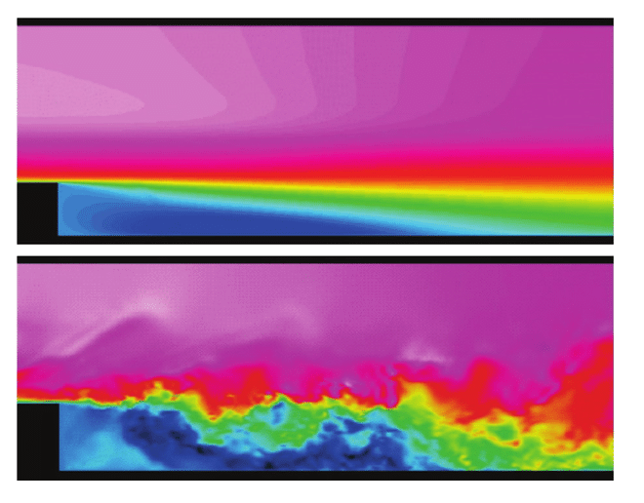
Solving Process
Transient | RANS
Time-resolved Resolved time-dependant flow structures | Time-averaged Mean flow characteristics, does not capture time dependant effects
High computational cost | Low computational cost
Turbulence resolved or minimally modelled | Modelled Turbulence
Best for dynamic flows | Best for steady-state flows
Needs a very fine mesh | Coarser meshes possible
RANS
Large-Eddy Simulation (LES)
Image: erdkunde.narkive.de
Notes:
- Focus here is on unstructured grids

Slide 13
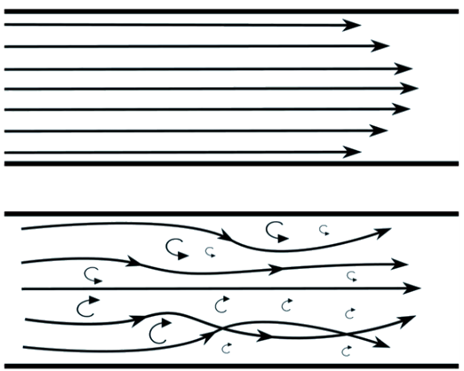
Turbulence Modelling
How can the effect of turbulence on the flow be modelled?
Boussinesq Approximation: Turbulent stress can be expressed like shear stress
Dynamic viscosity in the equations is replaced by the sum of laminar viscosity and turbulent viscosity
How can the turbulent viscosity be calculated?
Turbulence models are used to estimate the amount of turbulence with information from the flow quantities (velocity, shear)
Those models try to mimic the effect of turbulence on the flow quantities and are based on experiments which are used to “tune” the coefficients used in the model
Laminar
Turbulent
Notes:
- Focus here is on unstructured grids

Slide 14
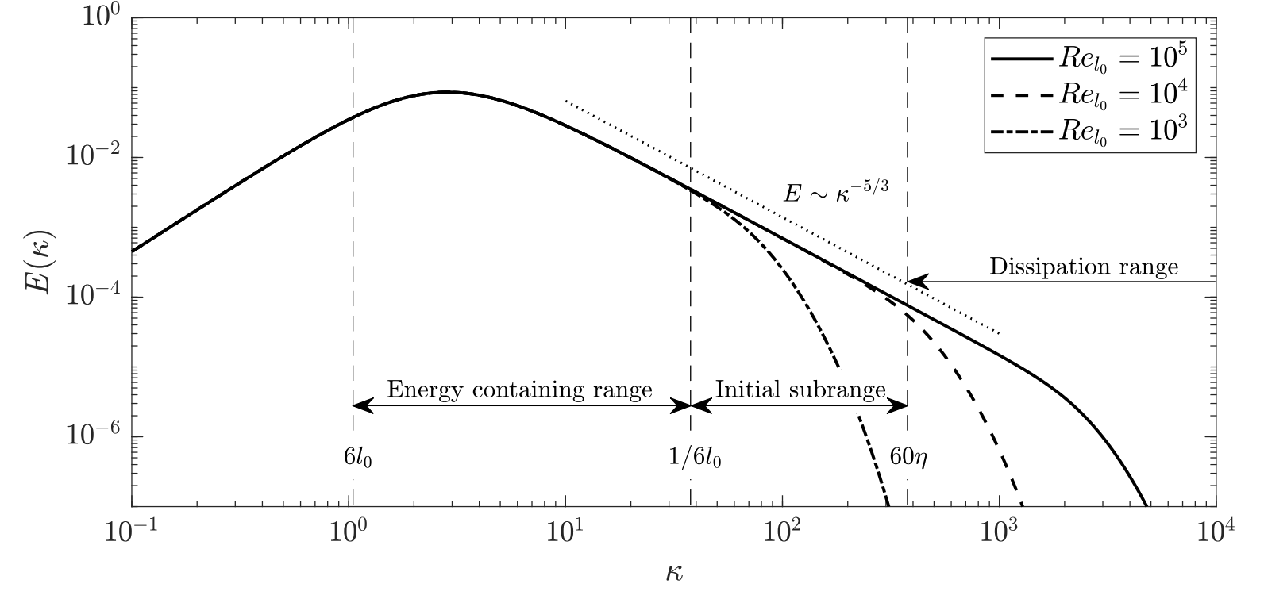
Turbulence Modelling
Energy of Eddies
(Eddy = „single turbulent structure“)
Model Energy Spectra
High Energy
Low Energy
Large Eddies
Small Eddies
Wave length
(1/Eddy Size)
Notes:
- Focus here is on unstructured grids

Slide 15
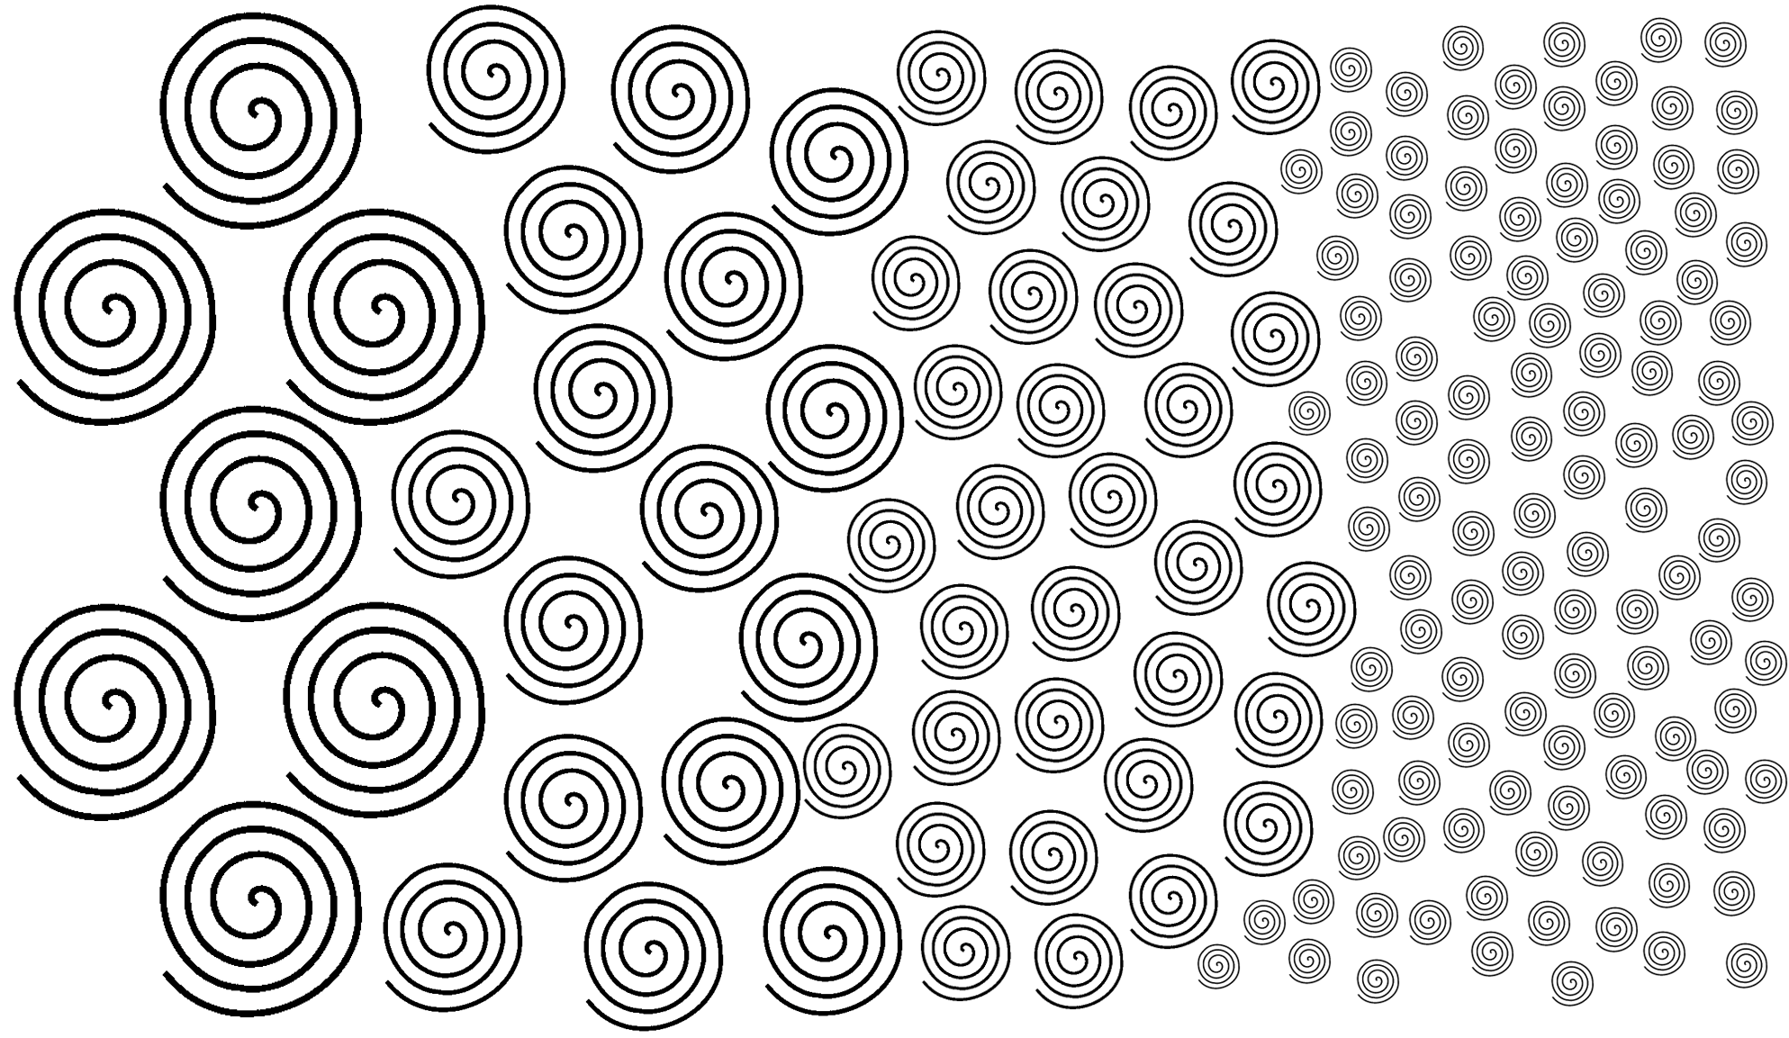
Turbulence Modelling
Isotropic eddies
Energy Injection
Energy Dissipation into heat
Energy Cascade
Notes:
- Focus here is on unstructured grids

Slide 16

Turbulence Modelling
Large-Eddy Simulation
Transient Simulation
Resolve large, anisotropic vortices that carry the most energy
Model small, isotropic vortices that dissipate energy
Turbulence Model “decides” what can be resolved and what is modelled based on mesh size
LES turbulence models are called “Sub-Grid Scale” (SGS) Models
These models are only designed to deal with very small, mostly energy dissipating, vortices
Resolving turbulence inside the boundary layer of the wall needs extremely fine meshes (up to 99% of all cells are placed inside the boundary layer)
Notes:
- Focus here is on unstructured grids

Slide 17
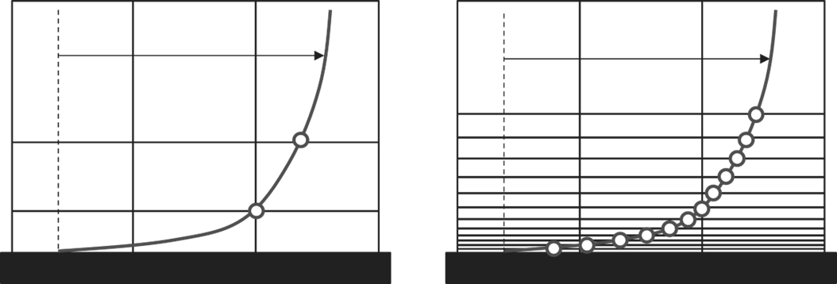
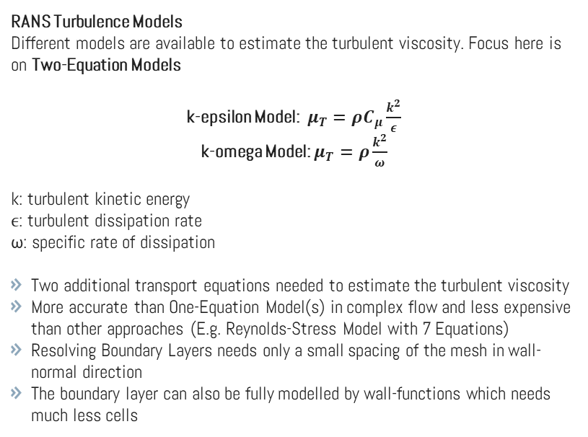
Turbulence Modelling
RANS Turbulence Models
Different models are available to estimate the turbulent viscosity. Focus here is on Two-Equation Models
k-epsilon Model: $μ_{T}=ρC_{μ}\frac{k^{2}}{ε}$
k-omega Model: $μ_{T}=ρ\frac{k^{2}}{ω}$
k: turbulent kinetic energy
ϵ: turbulent dissipation rate
ω: specific rate of dissipation
Two additional transport equations needed to estimate the turbulent viscosity
More accurate than One-Equation Model(s) in complex flow and less expensive than other approaches (E.g. Reynolds-Stress Model with 7 Equations)
Resolving Boundary Layers needs only a small spacing of the mesh in wall-normal direction
The boundary layer can also be fully modelled by wall-functions which needs much less cells
Wall Treatment
U
U
High y+
Using wall functions
Low y+
Resolved Flow
Notes:
- Focus here is on unstructured grids

Slide 18
Turbulence Modelling
 | Realizable k-epsilon | SST Menter k-omega
Formulation | Improved and more physically accurate than standard k-epsilon | Blends between k-omega near walls and k-epsilon in far field
Wall Treatment | Needs additional models for low y+ * | All y+
Transition | No** | No**
Adverse Pressure Gradients | Moderate | Excellent
Free-shear flows | Good | Moderate
Separated Flows | Poor | Excellent
Application | Not recommended for race car CFD. Lag elliptic-blending k-epsilon might be better, but computationally more expensive | Recommended for race car CFD
*Already implemented in most commercial CFD codes, **Possible with additional transition model
Notes:
- Focus here is on unstructured grids

Slide 19
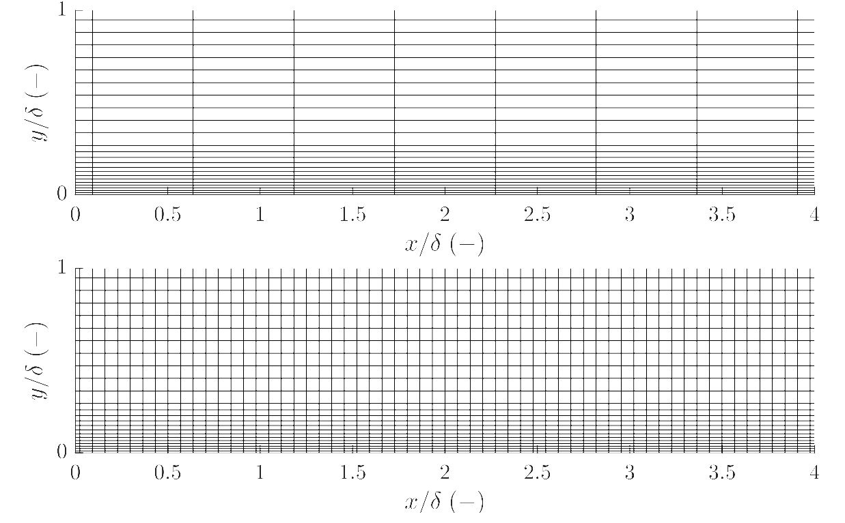
Turbulence Modelling
 | Advantages | Disadvantages/Problems
Steady-State (RANS) | Low computational cost Predicts mean flow well Low mesh requirements | Low accuracy for transient phenomena Limited in separated flows/high streamline curvature Empirical dependency
Transient (LES) | Captures detailed turbulent structures Great for unsteady and complex flows | High computational cost Difficult in handling near wall flow High mesh requirements
RANS near-wall Mesh
LES near-wall Mesh
Notes:
- Focus here is on unstructured grids

Slide 20
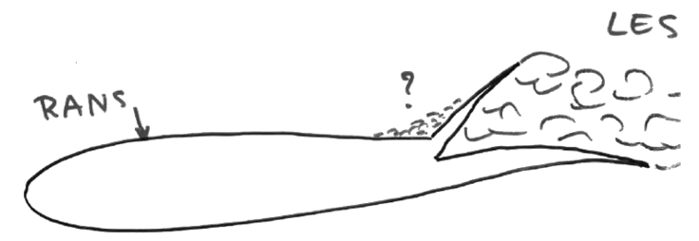
Turbulence Modelling
Original concept sketch of C.P. Spalart for his Detached Eddy approach (1997)

Slide 21
Turbulence Modelling
Hybrid RANS-LES Approach: Detached Eddy Simulation (DES)
Model near-wall flow with RANS model
RANS uses Spalart-Allmaras or k-omega Turbulence Model
Separated off-body flow with LES
Removes the requirement for very fine meshes inside the boundary layers
Overcomes weaknesses of RANS in the off-body flow
Boundary Layers are modelled with RANS limitations
Problems with (the position of) the interface between RANS and LES regions
Delayed-Detached Eddy Simulation (DDES)
Ensures the boundary layer is always treated by RANS and the interface to the LES region lies outside of the boundary layer
Should always be used instead of the original DES
Boundary Layers are modelled with RANS limitations
Improved-Delayed-Detached Eddy Simulations (IDDES)
Also known as Wall-Modelled LES (WMLES)
Places the RANS-LES interface just above the viscous sublayer of the boundary layer flow
Non-turbulent part of near-wall flow is treated by the RANS model
Operates in IDDES mode if mesh is fine enough near walls, otherwise in DDES mode
Highest accuracy of hybrid RANS-LES models
Higher mesh requirements than DDES and difficult to control the interface position
Notes:
- Focus here is on unstructured grids

Slide 22
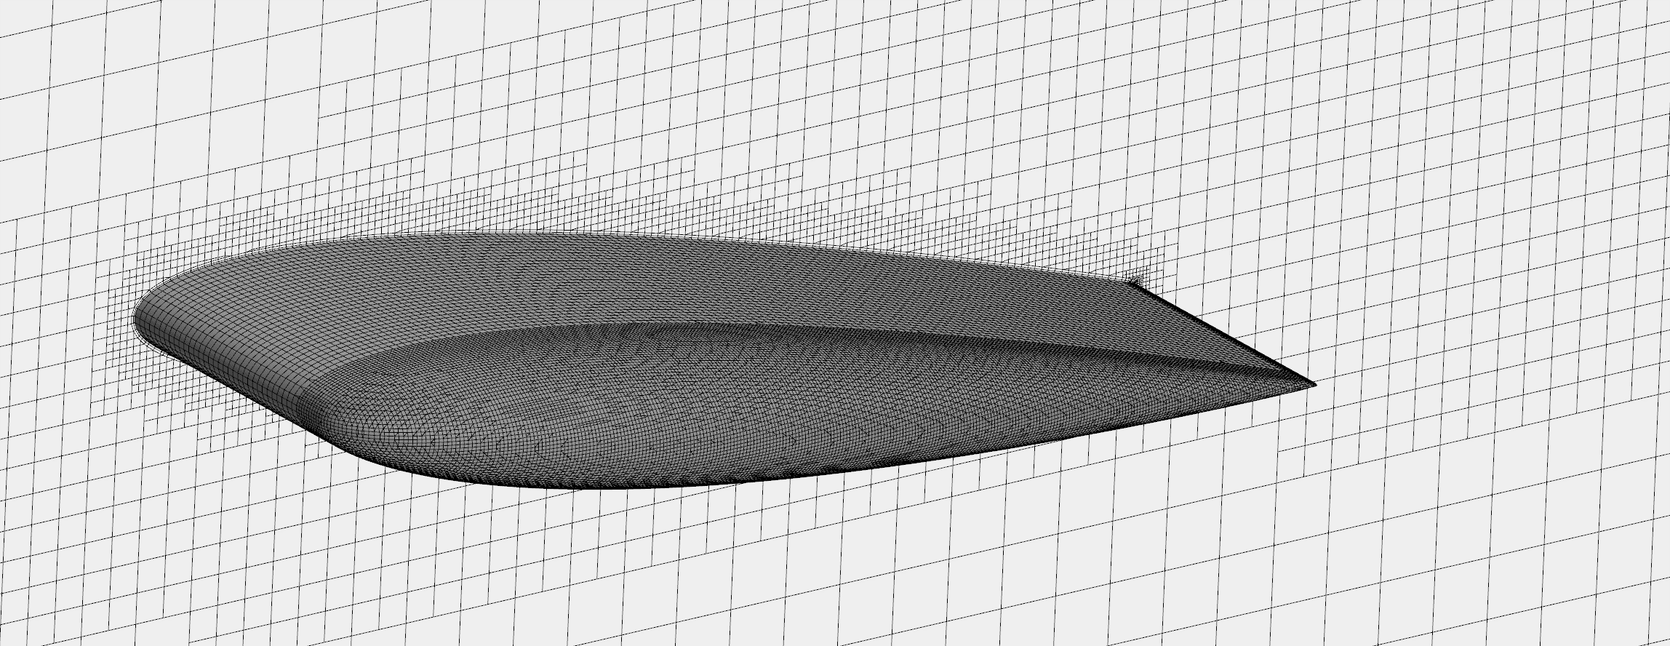
Meshing
The aggregation of control volumes is known as mesh or grid. Discrete control volumes are named cell or grid point
Different mesh types are used for different flow characteristics
Regions with high gradients of physical quantities require finer discretization
High gradients to be found around geometries, shear layers and shock waves

Slide 23
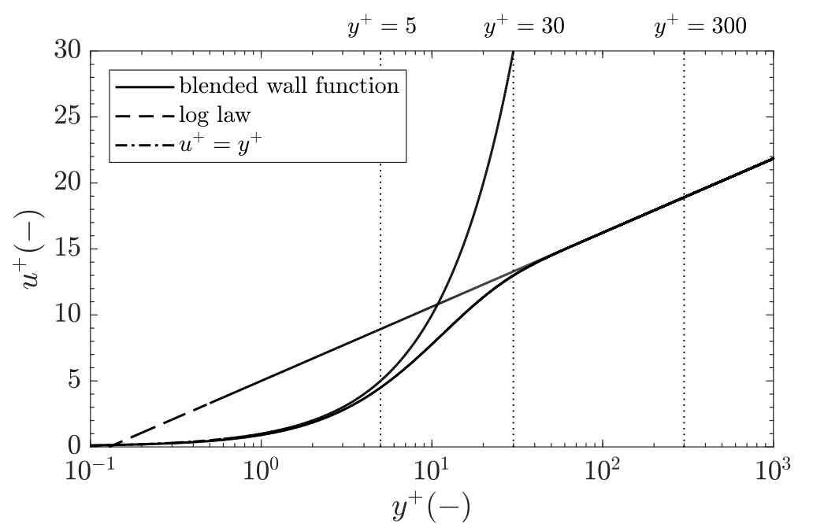
Meshing
Normalized Velocity
viscous sublayer
Buffer layer
Log layer
Velocity in viscous sublayer
Blended Velocity
Normalized Wall Disctance
Velocity in log-layer
(turbulent part of BL)
Notes:
- Focus here is on unstructured grids

Slide 24
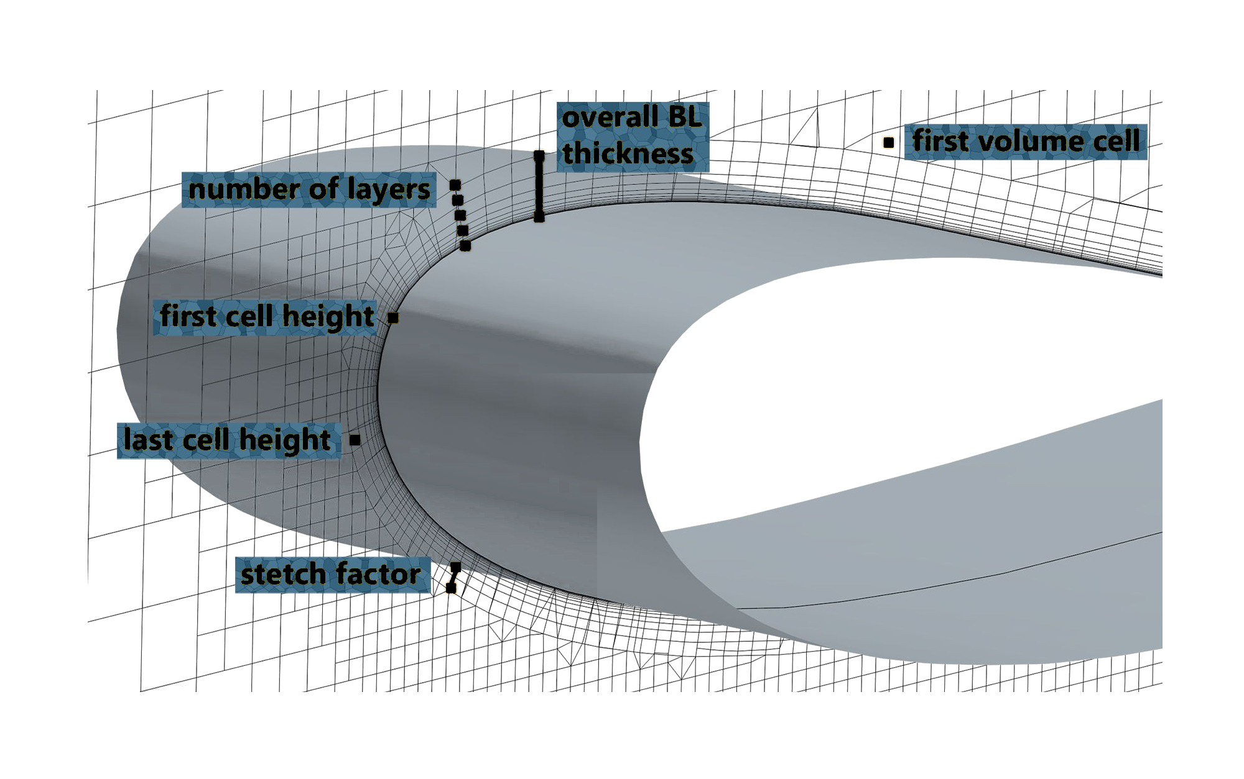
Meshing
Near Wall Meshing: Boundary Layer Mesh
Notes:
- Focus here is on unstructured grids

Slide 25
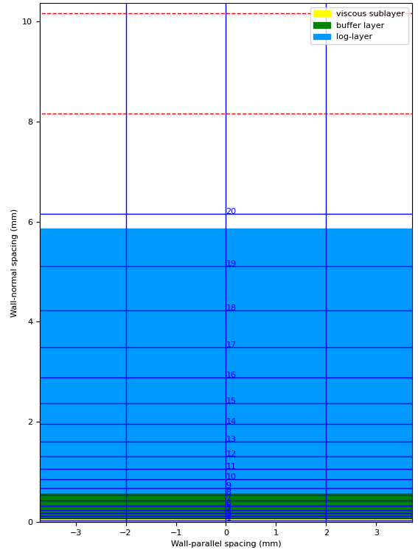
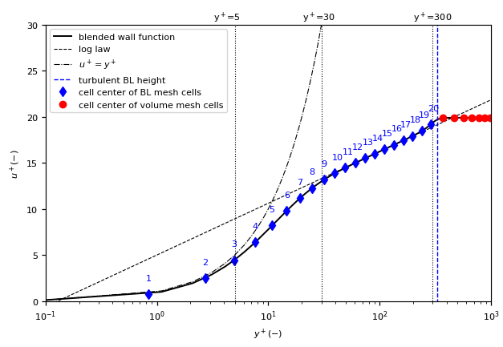
Meshing Low y+ Mesh
Notes:
- Focus here is on unstructured grids

Slide 26
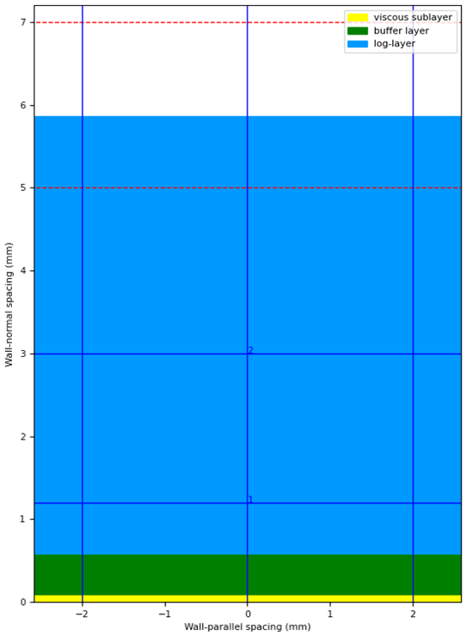
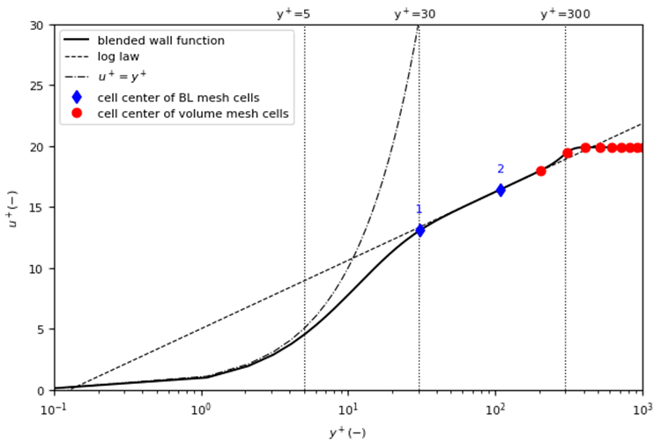
Meshing High y+ Mesh
Notes:
- Focus here is on unstructured grids

Slide 27
Boundary Conditions
Boundary conditions specify the values of flow variables at the boundaries of the simulation domain
Inlet: velocity, mass-flow
Outlet: Pressure, mass-flow
Walls: slip, no-slip, moving
Symmetry: mirroring the domain
Moving Geometry
Moving Reference Frames: Used for modelling rotation and translation with displacement for steady-state and transient simulations
Sliding Mesh: Rotation or translation of the mesh in transient simulations.
Porous Zones
Porous Zones/ Porous media: Used to model resistance on the fluid (radiators, filters)
Notes:
- Focus here is on unstructured grids

Slide 28
Limitations and Errors
Numerical
Turbulence modelling
- bluff body flows and highly separated flow
- separation and reattachment points
- high streamline curvature
- transition modelling
Discretization errors
- mesh resolution
- mesh quality
Convergence
Simplified Physics
Boundary Conditions and Geometry
Roughness
Inaccurate Geometry
Simplified Geometry
Wrong Assumptions for Boundary Conditions
Notes:
- Focus here is on unstructured grids

Slide 29
2
Race Car CFD

Slide 30
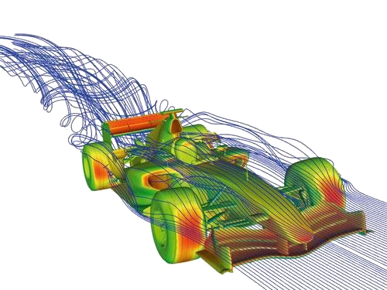
Heat Management
Radiators
Fans
Brakes
Tyres
Rotating
Deformed
Contact Patch
Roughness
Ground
Moving
Roughness
Suspension
Moveable Parts
Domain
Symmetry
Cornering Flow
Submodels

Slide 31
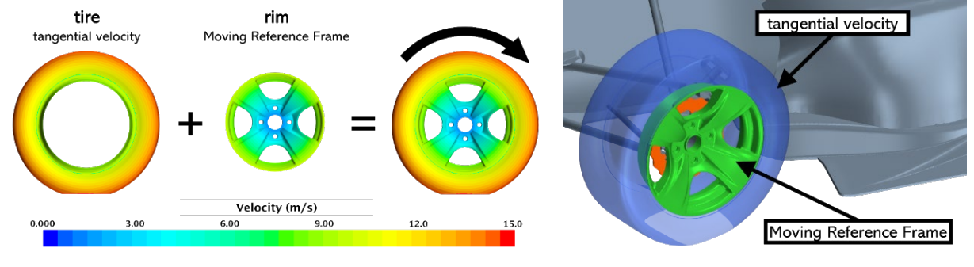
Tyres
Moving Reference Frame (MRF):
Modeling technique to simulate flows relative to a moving system
Rotating/Translating Coordinate System where rotating components appear stationary relative to this frame
Introduction of additional centrifugal and Coriolis forces
Notes:
- Focus here is on unstructured grids

Slide 32
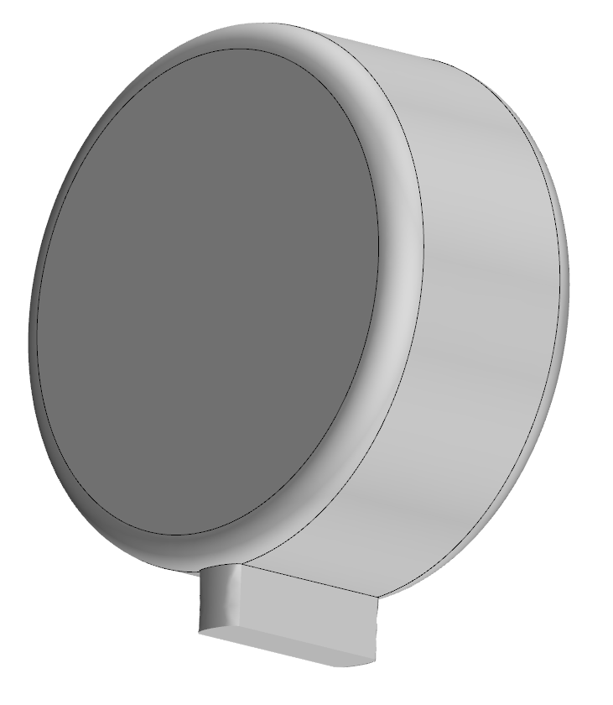
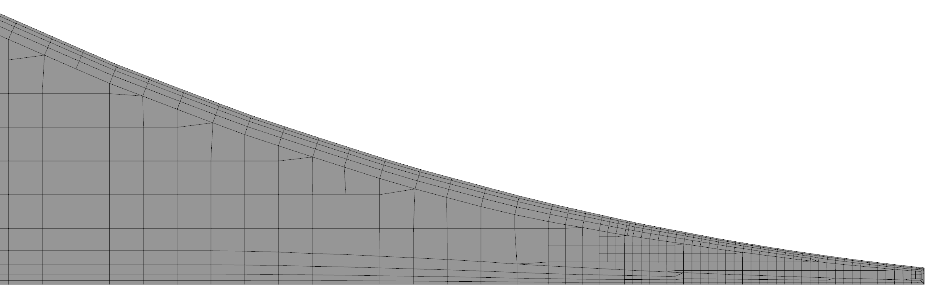
Tyres
Notes:
- Focus here is on unstructured grids

Slide 33
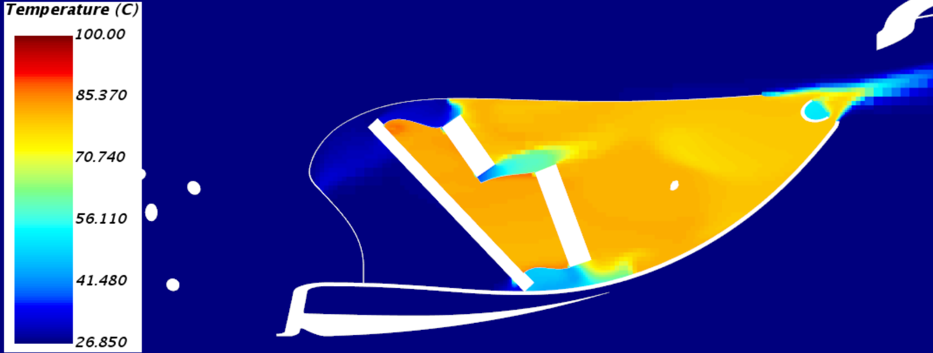
Heat Management
Radiators are modelled with a porous media: Artificial Resistance to model the pressure drop of the radiator
Monitor flow uniformity and mass flow distribution on radiator surface
You can apply a heat source to the radiator
Porous Media / Porous Zone
Artificial Resistance in all 3 spatial directions
Fans
Modelled with a „Fan Interface“ or MRF
© Rennstall Esslingen
Notes:
- Focus here is on unstructured grids

Slide 34
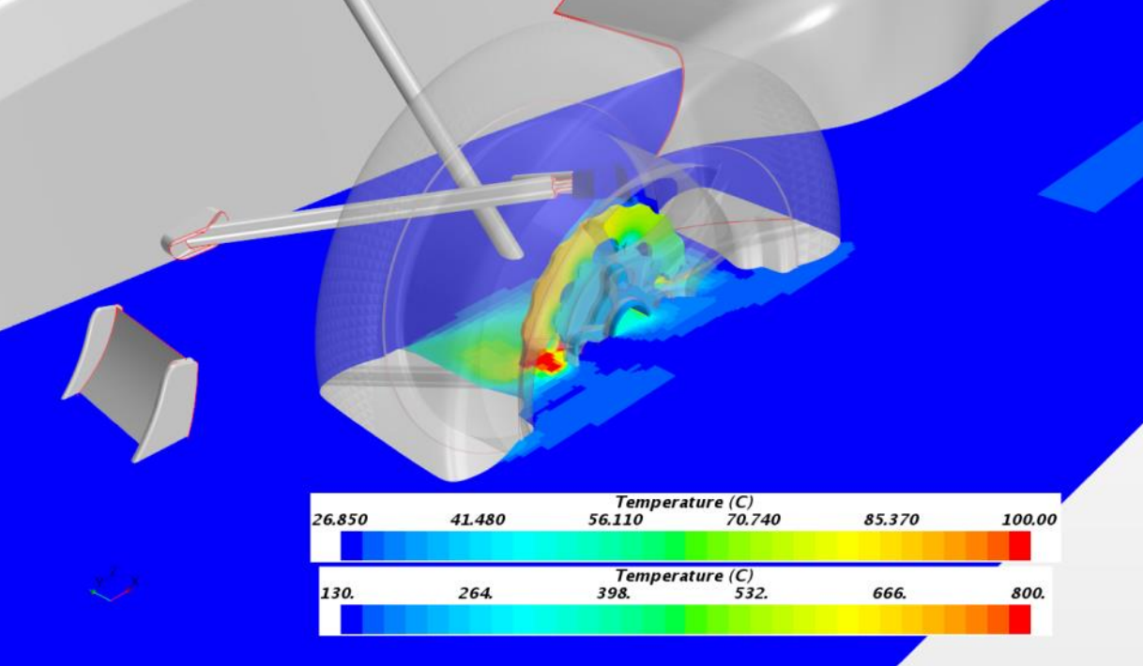
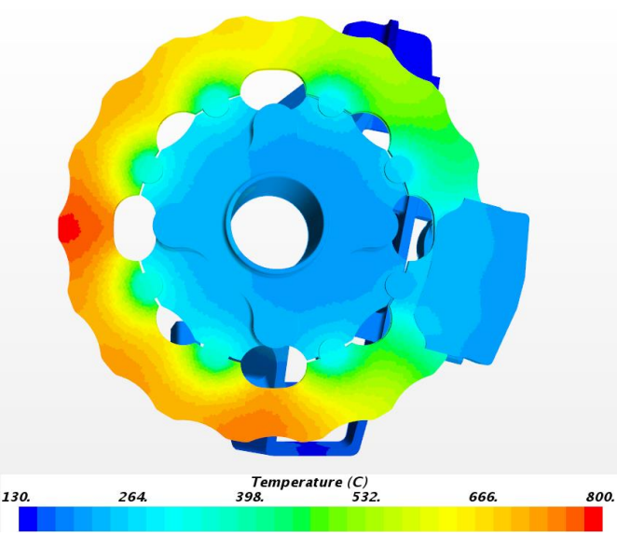
Heat Management
Brake Cooling
© Rennstall Esslingen
© Rennstall Esslingen
Notes:
- Focus here is on unstructured grids

Slide 35
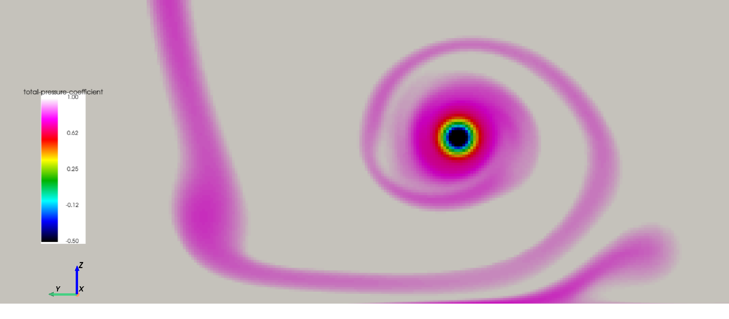
Ground
Moving Wall
Ground slip angle for Cornering
Roughness
Mesh
Strong Interaction with Vortices and lateral Flow
Secondary Vortex
Primary Vortex
Ground Plane
Notes:
- Focus here is on unstructured grids

Slide 36
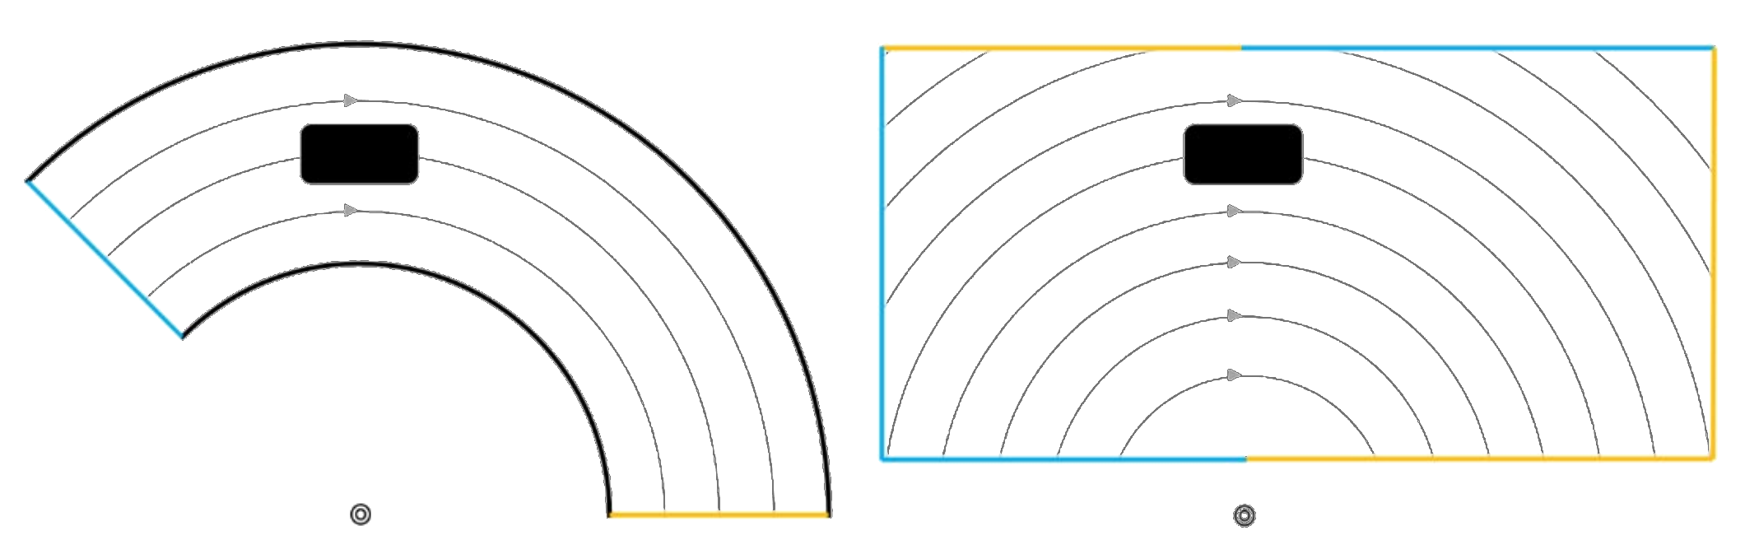
Domain
Straight line: Rectangular Domain
Curved Flow: Curved or Rectangular Domain with “Moving Reference Frame”
Inlet
Outlet
Walls
Notes:
- Focus here is on unstructured grids

Slide 37
3
A Workflow for Formula Student

Slide 38
Process Overview
01
03
05
Suspension & Tyres
Domain/Mesh
CAD
Solver
Posting
02
04

Slide 39
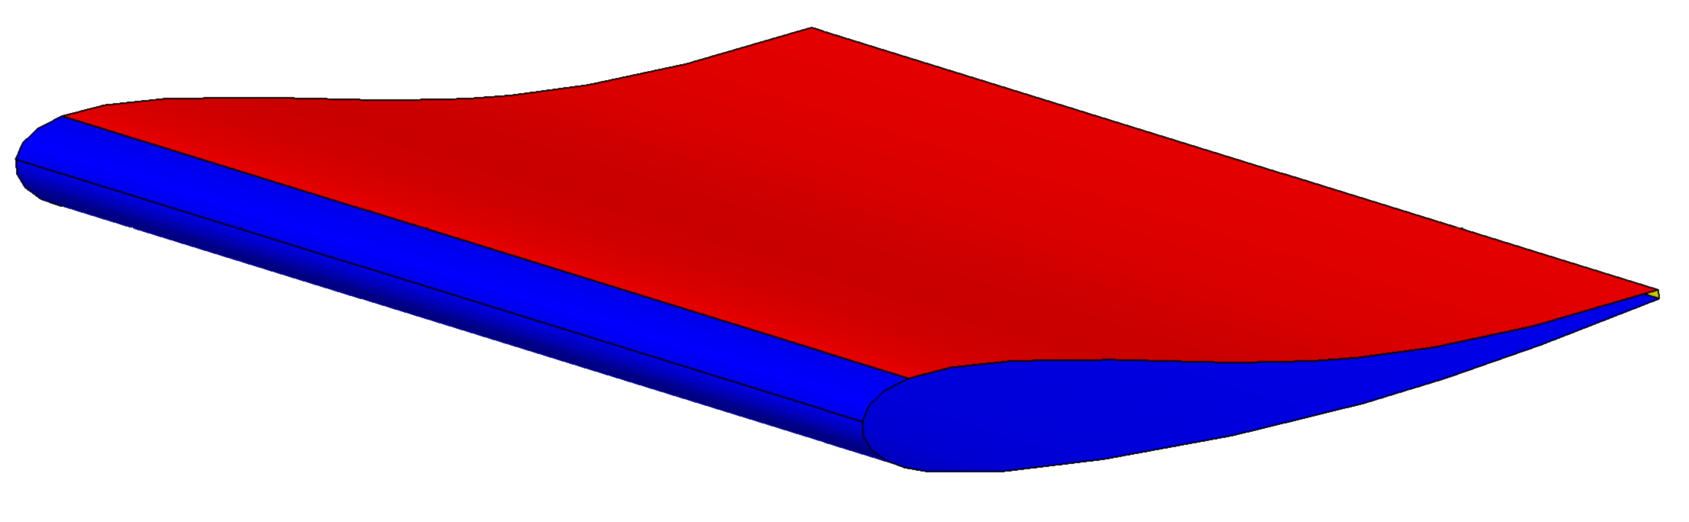
01 CAD
Split Patches in CAD for efficient meshing strategies
Create efficient Mesh Refinement Boxes in CAD
Create Massflow-Planes in CAD
Model the driver as accurate as possible for rear wing onset flow prediction
Wing Patches
Suction
Pressure
Trailing Edge
Shedding Edge
Wrap Suction Surface around leading edge
Notes:
- Focus here is on unstructured grids

Slide 40
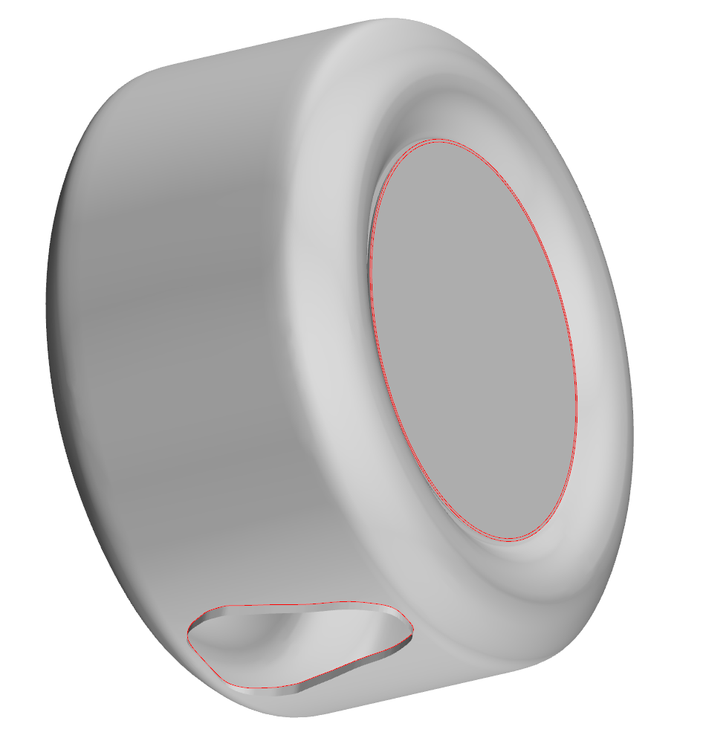
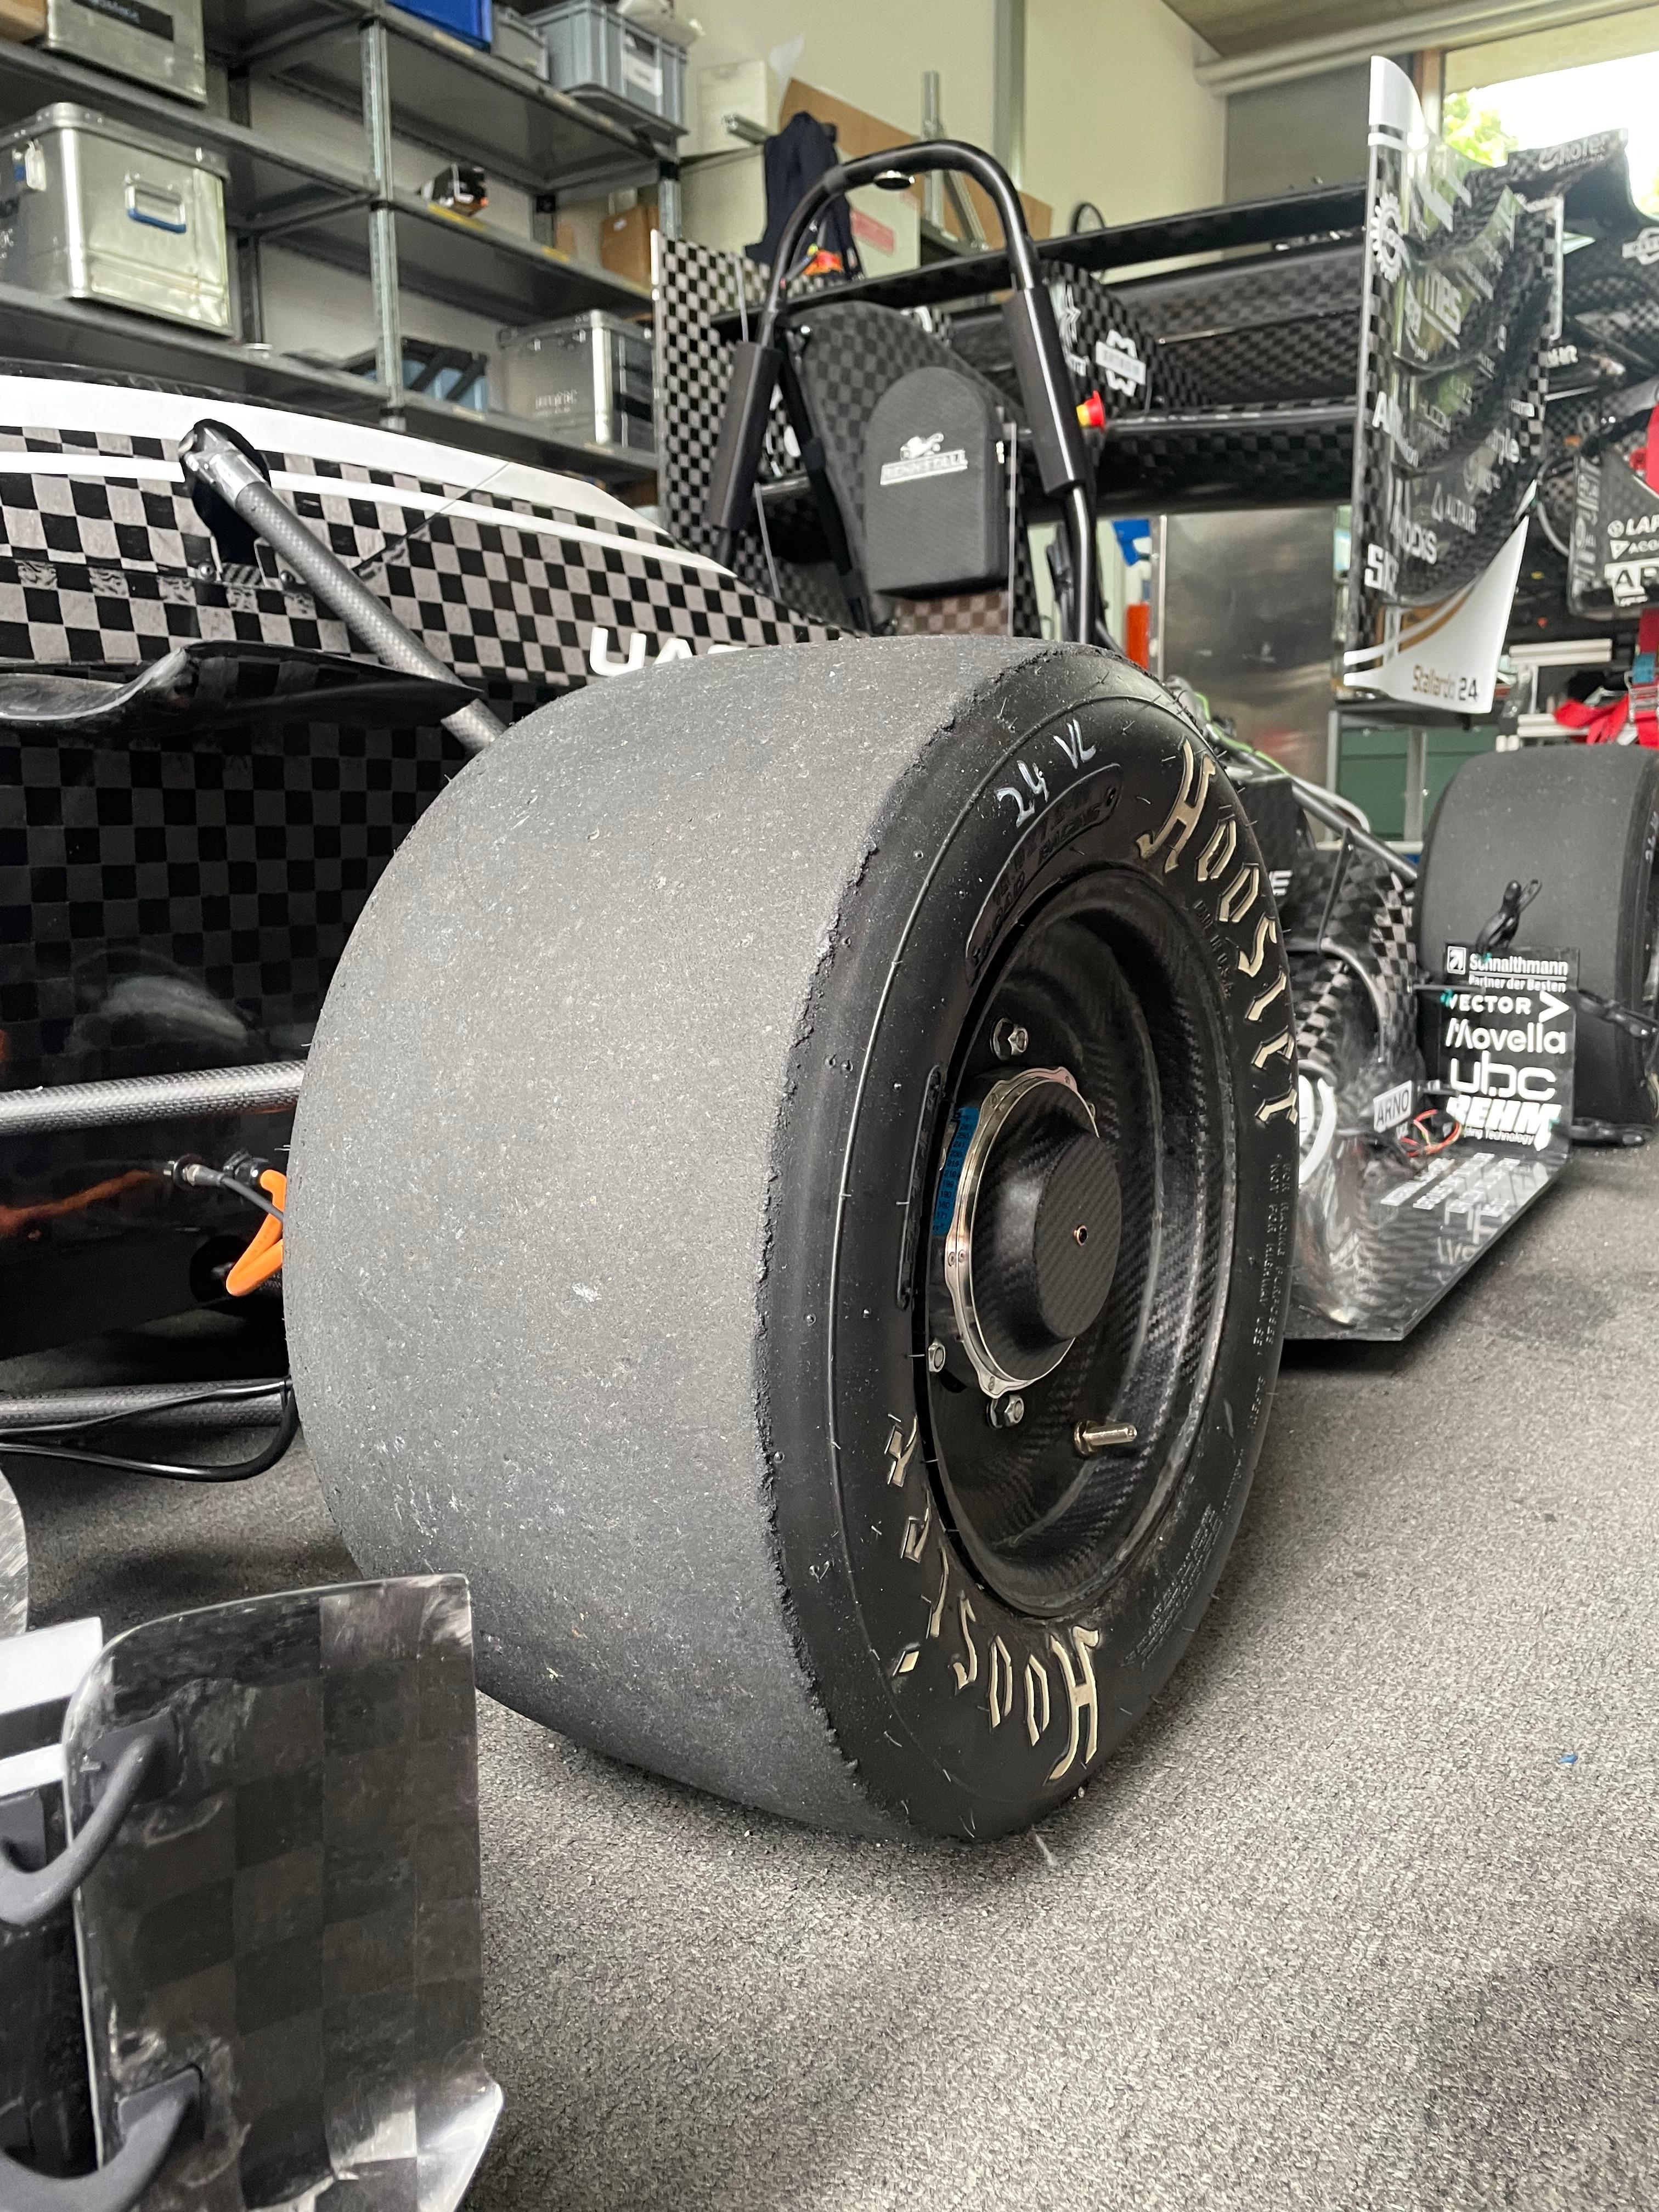
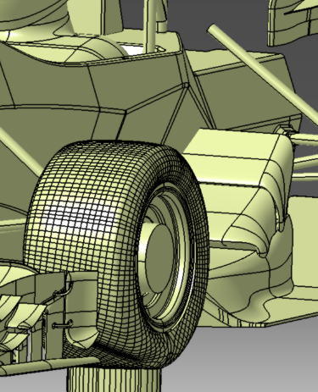
02 Suspension & Tyres
Create (simple) functions to adjust the suspension
Recreate the tyre contact-patch deformation
Separation Point on tyre crucial for tyre wake prediction
© Rennstall Esslingen
© Rennstall Esslingen
© Rennstall Esslingen
Notes:
- Focus here is on unstructured grids

Slide 41
03.1 Domain
Sidewalls
Slip condition or Symmetry
Velocity Inlet
Fixed Velocity
Pressure Outlet
Ambient Pressure
Min. 2-3 car lengths
Straight line flow
Height
Min. 4 car heights
More when strong upwash from wings
Approx. 5 car lengths
Approx. 10+ car lengths
Notes:
- Focus here is on unstructured grids

Slide 42
03.1 Domain
Yaw Simulations
Rotate Car for Yaw Simulations
This is not a cornering simulation !
Straight line flow
Notes:
- Focus here is on unstructured grids

Slide 43
03.1 Domain
Rotate Car to account for Slip Angle
Additional car rotation applies ground plane slip angle
Use a Moving Reference Frame to model the curved flow
Change Inlet Boundary Condition to velocity = 0
Notes:
- Focus here is on unstructured grids

Slide 44
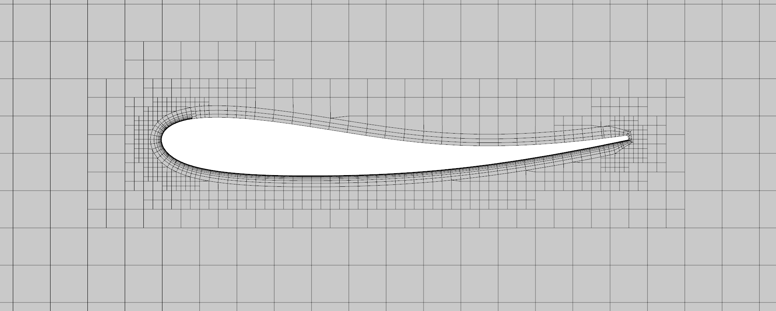
03.2 Mesh
Be smart with your wall-treatment and refinements
Use Boxes for refining the mesh where you need it
Offset Surfaces or Distance Refinements for Geometry related meshing
Mesh Study
Trailing Edge
High yPlus
Fine mesh
Few layers
Pressure Surface
High yPlus
Coarser mesh
Use Curvature Refinements
Suction Surface
Low yPlus
Fine mesh
Distance refinement
Notes:
- Focus here is on unstructured grids

Slide 45
03.2 Mesh
Mesh Study
Perform wall-based and volume-based mesh studies
Wall-base: low and high yPlus, number layers, thickness of layered mesh and thickness of first cell height
Investigate every flow structure separately
Get a feeling where the critical and most sensitive areas are
Do not just compare loads, compare the flow field and skin friction
Notes:
- Focus here is on unstructured grids

Slide 46
04 Solver
First Choice:
Coupled Solver
Usually faster than Segregated Solver
Higher Memory Requirements
Try decreasing the computational effort for solving by keeping the simulation stable: Under Relaxation, Pre- and Postsweeps, Number of Iterations for the linear Solver, Cycle type, CFL number
Alternative:
Segregated Solver
Use it when you get memory exceptions with the coupled solver
If you have convergence issues with coupled solver
Coupled solver probably not available in your CFD code
Notes:
- Focus here is on unstructured grids

Slide 47
04 Solver
Solutions for limited computational resources
Only RANS simulations, transient does not make sense for development
Try optimizing your mesh to reduce cell count by maintaining a good level of accuracy
→ Formula Student CFD should have at least 40-60mio Cells Fullcar
→ If that is not possible, you can still use your CFD but do not assume the loads and flow field is fully correct
Use Sub-Models for Development:
- Frontwing + Front Wheel + Front Chassis
- Rear Models with mapped Inlet conditions
- You can also use models with a coarser mesh at the front/rear but be aware of inaccuracies
Do not use 2D simulations!
Notes:
- Focus here is on unstructured grids

Slide 48
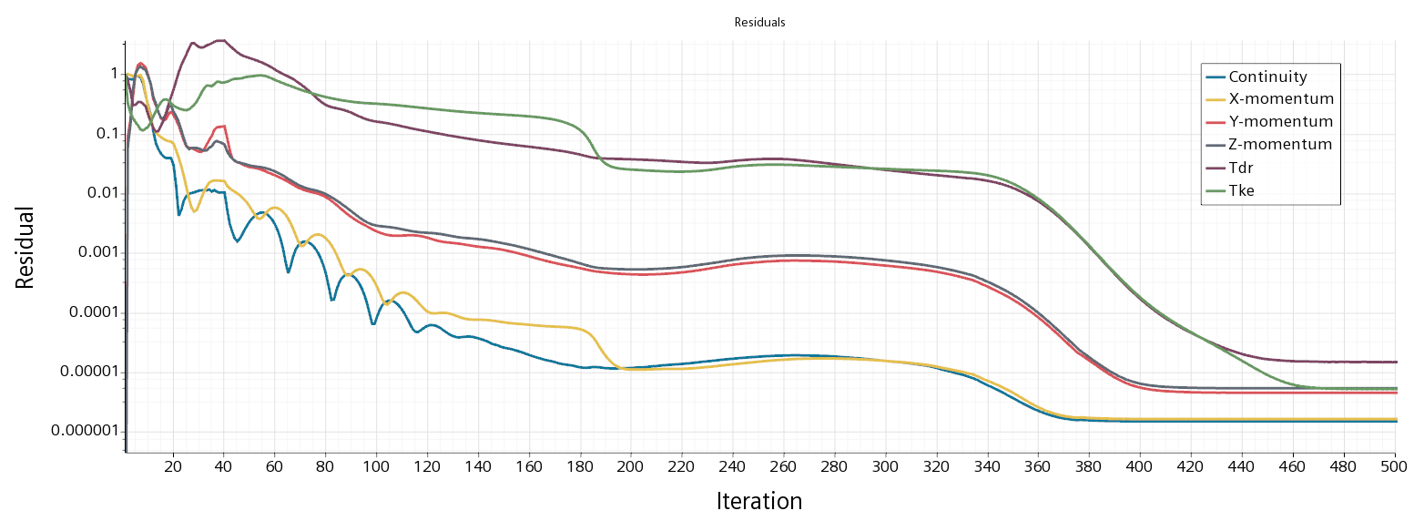
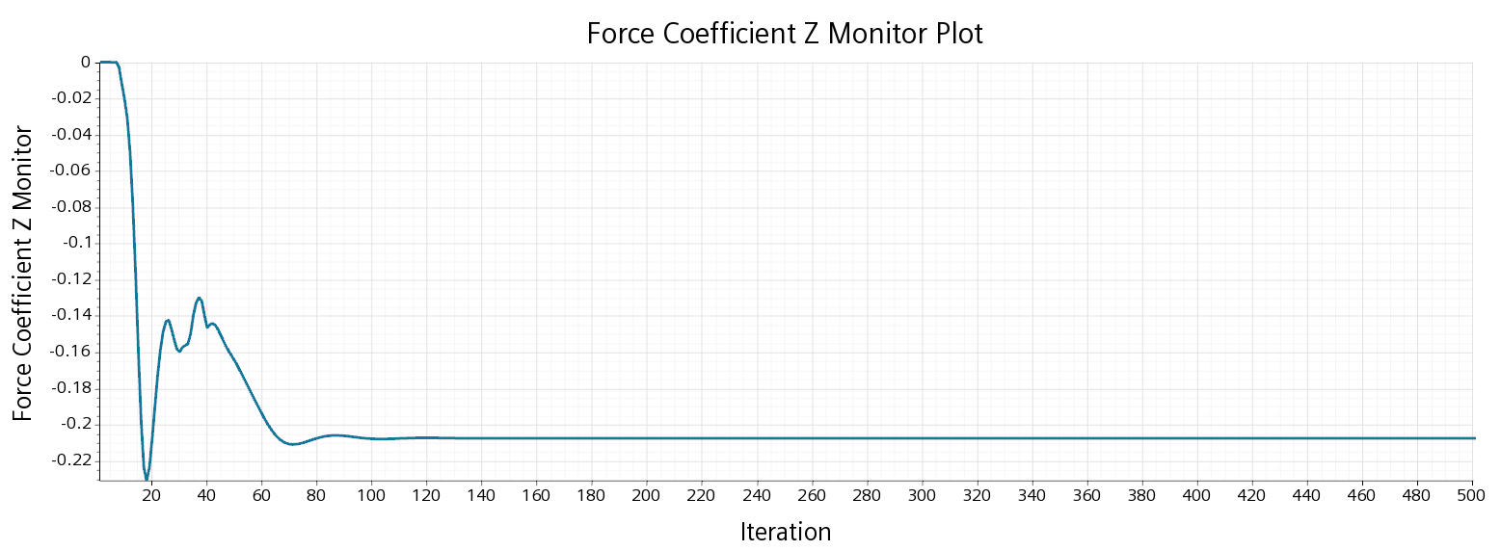
04 Solver
1st Order Convergence
2nd Order Convergence
Convergence
Residuals: Difference between current and last iteration
Rule of thumb: Residuals should drop by 3 Magnitudes
Monitor Forces, not only residuals
Drop of 3 Magnitudes
Steady State for Force reached
Notes:
- Focus here is on unstructured grids

Slide 49
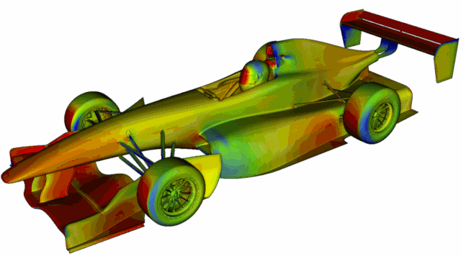

05 Postprocessing
General
Use a coordinate System that is steady relative to the unsprung car
Normalize all variables and forces
Use the right colorbars and fixed limits
Use massflow planes to monitor the massflow through brakes, radiators, …
You can also use massflow planes to monitor the total pressure average in some areas
Calculate aero balance
Output forces, massflow, balance, … in a way that you can easily compare them
Postprocessing should be automated and repeatable!
1
1
1: racetechmag.com/2019/02/willem-toet-explains-cfd-post-processing
Notes:
- Focus here is on unstructured grids

Slide 50
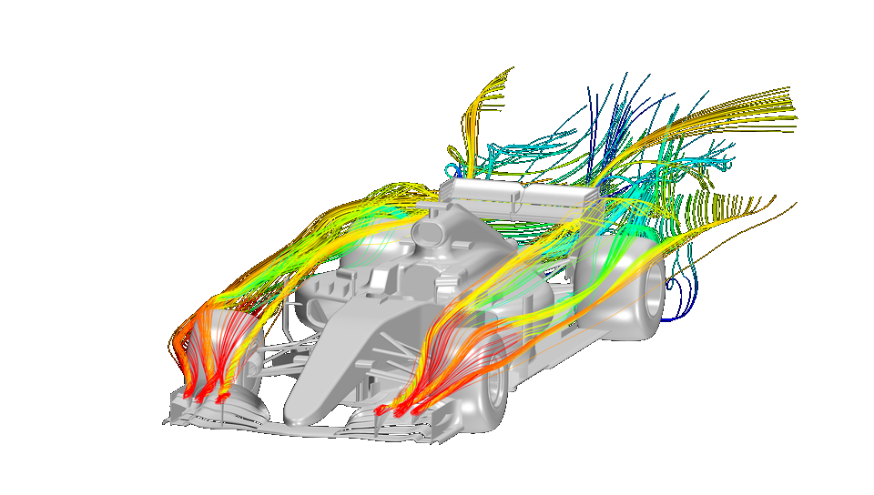
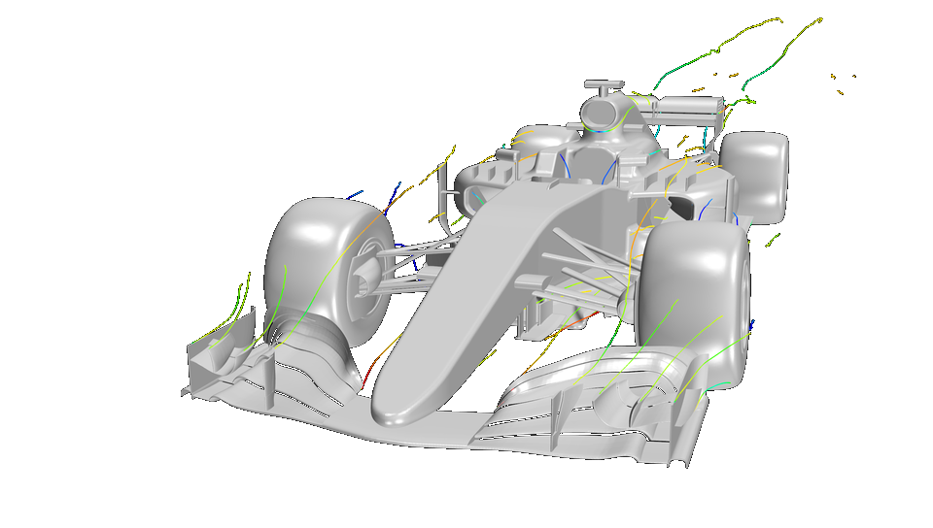
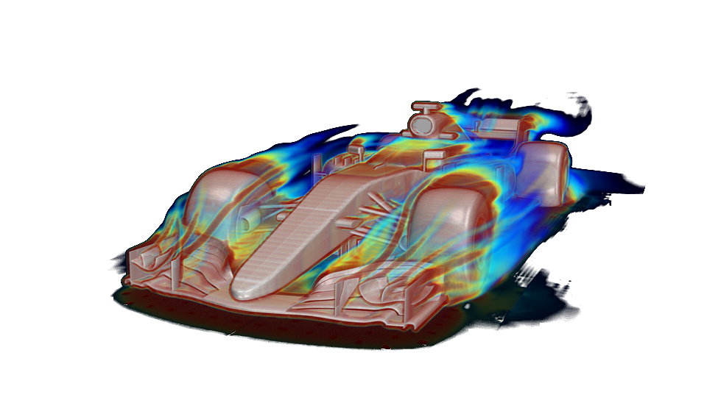
05 Postprocessing
Flow Field Visualization
Understand the flow field
Streamlines
Vortex Cores
Iso-Surfaces
- Total Pressure
- Vortex Criterion: Helicity/ Q or Lambda2
Line Integral Convolution (LIC)
- Velocity components for cutting planes
- Skin Friction components for surfaces
Notes:
- Focus here is on unstructured grids

Slide 51
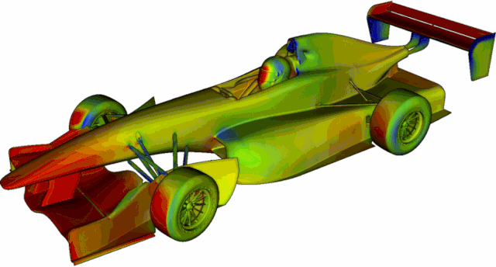
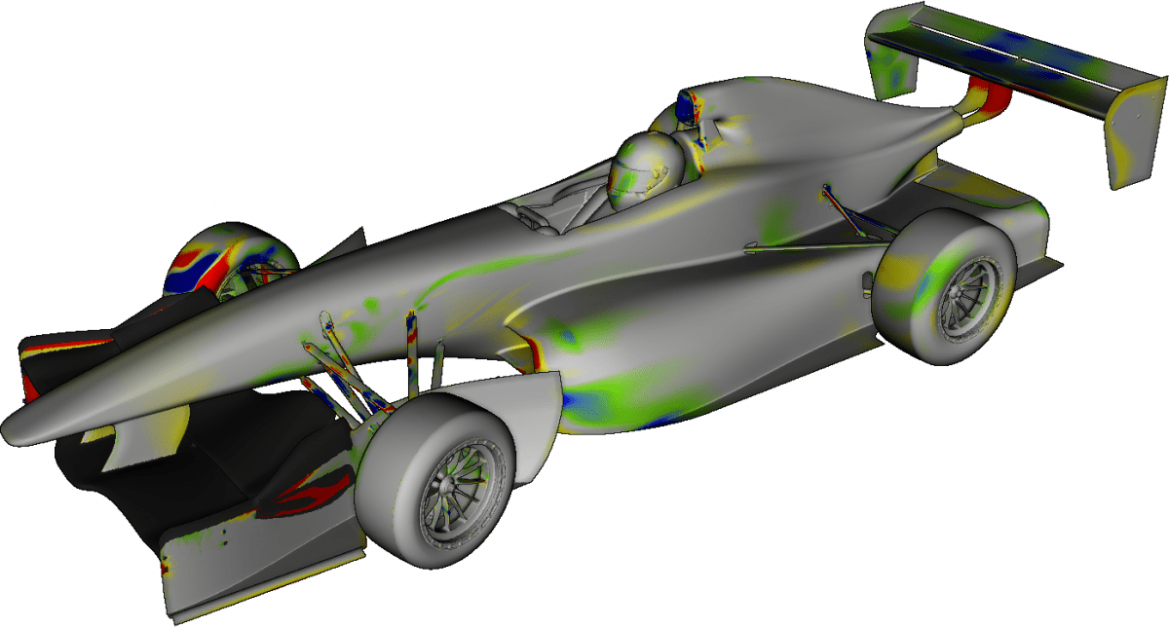
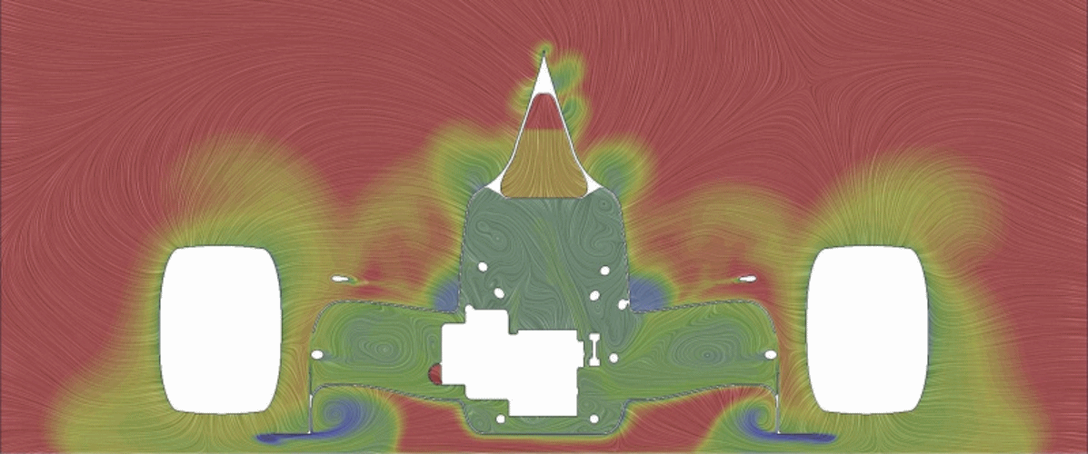
05 Postprocessing
Flow Field Visualization
To compare design iterations
Cutting Planes
- Total Pressure
- Pressure
- Vortex Criterion
- Velocity (+ Components)
Surface Variables
- Pressure
- Skin Friction
Delta Calculation
Surface Slice Plots
- Pressure
- Skin Friction
1
1
1
1: racetechmag.com/2019/02/willem-toet-explains-cfd-post-processing
Notes:
- Focus here is on unstructured grids

Slide 52
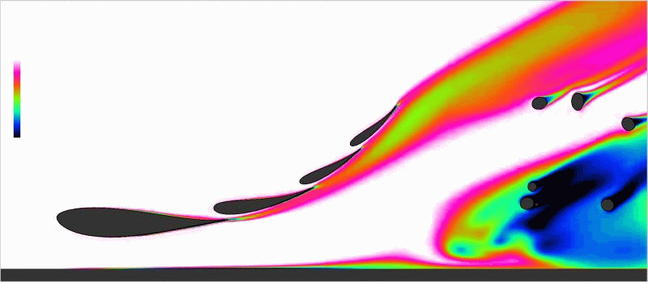
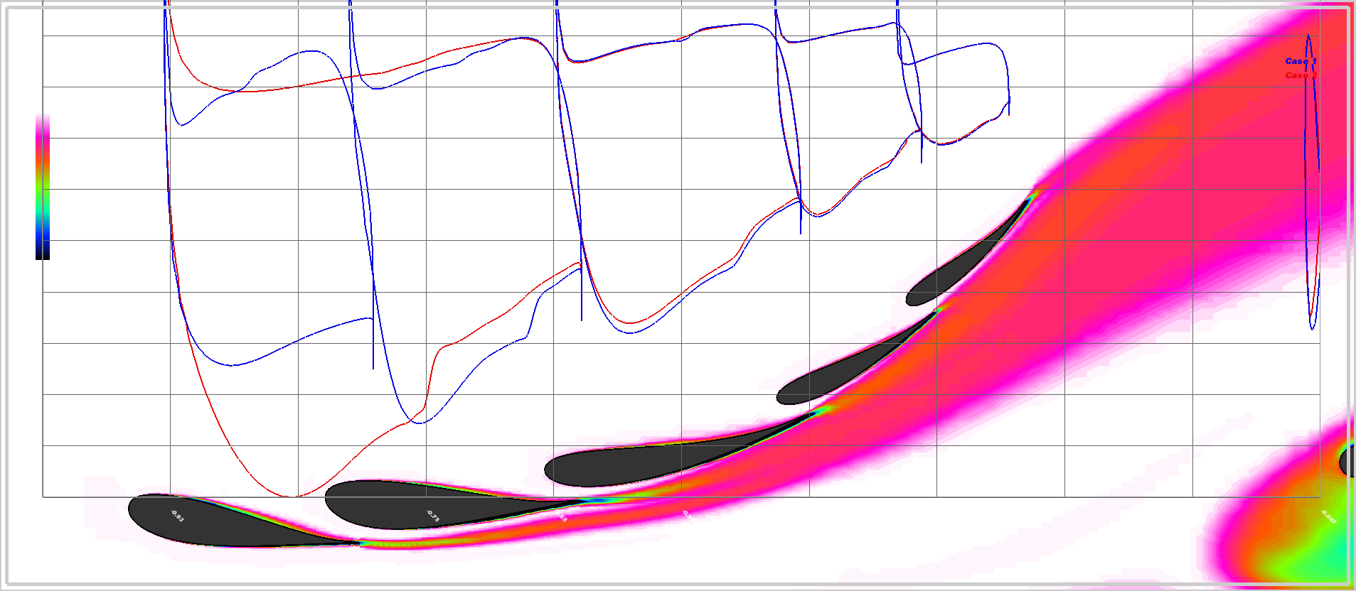
05 Postprocessing
Flow Field Visualization
To compare design iterations
Cutting Planes
- Total Pressure
- Pressure
- Vortex Criterion
- Velocity (+ Components)
Surface Variables
- Pressure
- Skin Friction
Delta Calculation
Surface Slice Plots
- Pressure
- Skin Friction
Notes:
- Focus here is on unstructured grids

Slide 53
4
Validation and Correlation

Slide 54
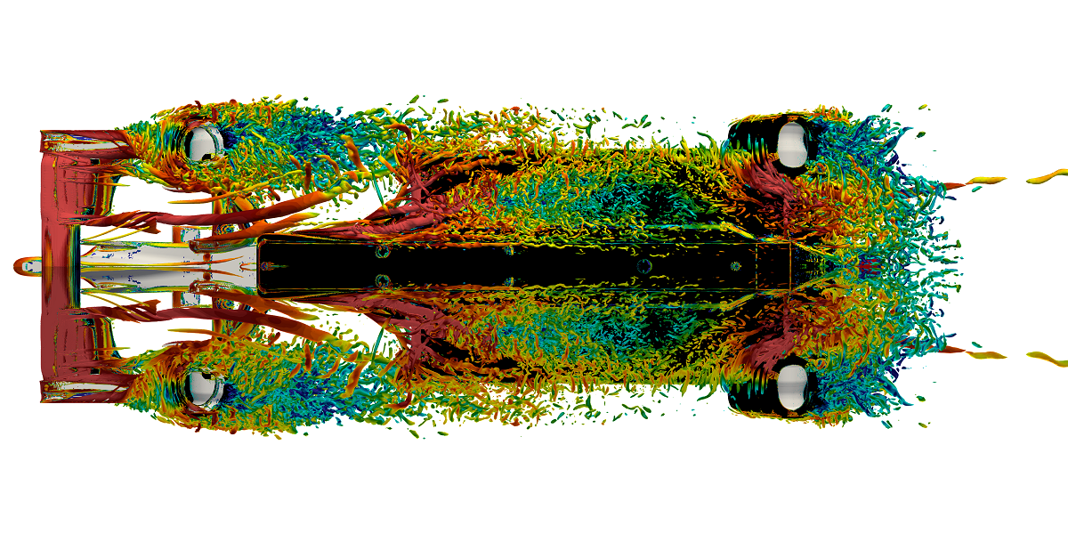
Data Collection
Where to get your data to correlate to from?
Track testing
Windtunnel
Wool tufts
Flow viz paint
Pressure taps
Aero Rakes
Load measurement
High Fidelity Simulations
Volume and surface field data
Loads
Notes:
- Focus here is on unstructured grids

Slide 55

Data Collection from CFD
Turbulence Modelling one of the main issues in RANS
We can use high fidelity CFD to get an idea of how close the RANS flow field is to the resolved turbulence
This is not a validation of the whole simulation, but good to highlight some issues and the understanding of the RANS limits
Best to compare:
Wheel wakes
Vortex Positions, Vortex Strength and possible Bursts
Loads
Notes:
- Focus here is on unstructured grids

Slide 56
Adress the Problems
Separation
Wing separates or separation point different from CFD
Check Geometry
Check mesh
Check onset flow
Is it laminar separation?
Check turbulence model
Investigate model parameters
Different Flow Field
Wakes and losses in different position
Check Geometry
Is there a different separation behaviour upstream?
Mesh sensitivity
Does it look less or more dissipated? → try other turbulence model or adjust turbulence model
Investigate surface roughness
Different Vortex Behaviour
Vortices appear stronger/weaker, burst or in different position
Check Geometry
Mesh sensitivity
Check Curvature Correction is activated and check parameters
Adjust turbulence model parameters
Notes:
- Focus here is on unstructured grids

Slide 57
5
Future Trends in CFD

Slide 58

Adjoint
Equations derived from the Navier-Stokes Equations
Fixed flow field to determine sensitivity gradients of design variables (mostly shape of geometry)
Allows for optimization of an objective function (drag reduction or downforce generation)
Can be applied in an optimization cycle
Sensitivity result will give an indication of how to deform the geometry
Limitation: Linear behaviour
© Rennstall Esslingen
Notes:
- Focus here is on unstructured grids

Slide 59


GPU Based Solving
CPU (Central Processing Unit): Optimized for sequential processing with a few powerful cores
GPU (Graphics Processing Unit): Designed for parallel processing with thousands of smaller cores
Matrix operations in linear algebra are highly parallelizable
Bandwidth of communication between CPUs slows down the computation for simulations with many CPUs (non-linear scalability of number of CPUs to solve time)
GPUs can deliver significant speedups over CPUs, especially for large and transient simulations
GPUs still show an extreme development trend compared to CPUs
Images: Siemens, Star-CCM+
Notes:
- Focus here is on unstructured grids

Slide 60

GPU Based Solving
Limitations
GPUs often have less memory than CPUs
not all software supports GPU solving
Availability and Cost of computing resources (GPUs also very attractive for Machine Learning)
Meshing better suited for CPU processing
The future will likely be a hybrid CPU-GPU setup to leverage the strength of both setups
Image: Nvidia
Notes:
- Focus here is on unstructured grids

Slide 61
Machine Learning
Machine Learning is a branch of artificial intelligence that enables systems to learn patterns from data and make predictions or decisions without being explicitly programmed.
Machine Learning in CFD used to:
Reduce computational cost
Enhance Turbulence Modelling
Analysis of Simulations
Assisting in Setup work and automate Workflows
Improve accuracy
Challenges:
Model needs to be trained with lots of data
Interpolation better performed than extrapolation
Extensive Validation required
Ensuring Physics
Notes:
- Focus here is on unstructured grids

Slide 62
Machine Learning
Surrogate Modelling
Predicting the Solution without solving the NS-Equations
Trained with data from previous simulations
Predictions made by interpolating/extrapolating from the training dataset
Turbulence Modelling
Enhance existing TM by learning from high-fidelity data
Adjustment of TM for different flow regimes and characteristics
Up to full replacement of TM with AI Model
Accelerating Solvers
Initialize the simulation with an assumption from the ML model
Convergence acceleration by solver adjustments from the model
Workflow and Setup Assistance
ML to help setting up CFD cases
Assisting in mesh generation
Adaptive mesh refinements
Notes:
- Focus here is on unstructured grids

Slide 63

Join the Audi F1 Project
Graduate Opportunities
Who We’re Looking For:
We’re offering entry-level positions for recent graduates across various departments:
Engineering
Aerodynamics
Design
Data Analysis
Business Operations
Your profile:
A Bachelor’s or Master’s degree in a relevant field.
A genuine love for motorsport and a desire to be part of Formula 1.
Strong analytical, problem-solving, and teamwork abilities.
Excellent communication skills and attention to detail.
Adaptability and a willingness to learn in a fast-paced, ever-evolving environment.
Relevant internship or experience in the motorsport or automotive industries is a plus, but not essential.
Full professional proficiency in English and a willingness to learn basic German.
Internships
Join us on a full-time internship over 6 month or up to a year!
Check our website for open position.
Trainee Program
Will be launched in 2025. Rotate through various engineering departments within the team over 24 months and find the position that fits you the best!

Slide 64


Audi F1 Project
sauber-group.com/corporate/jobs

